Slide 1


Slide 2
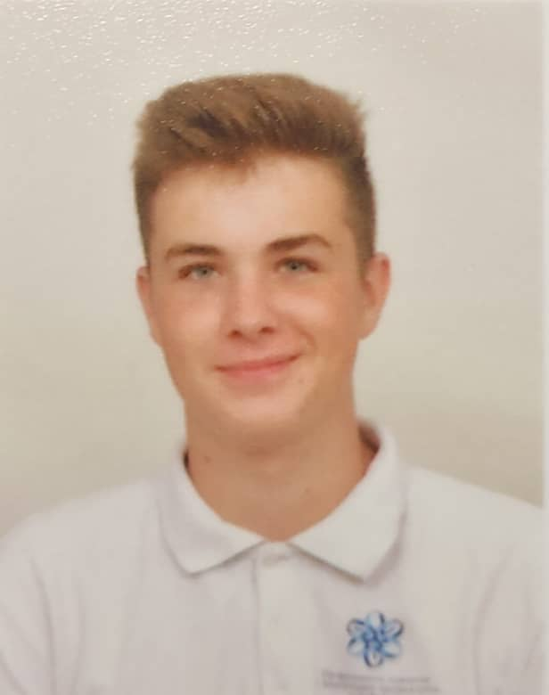
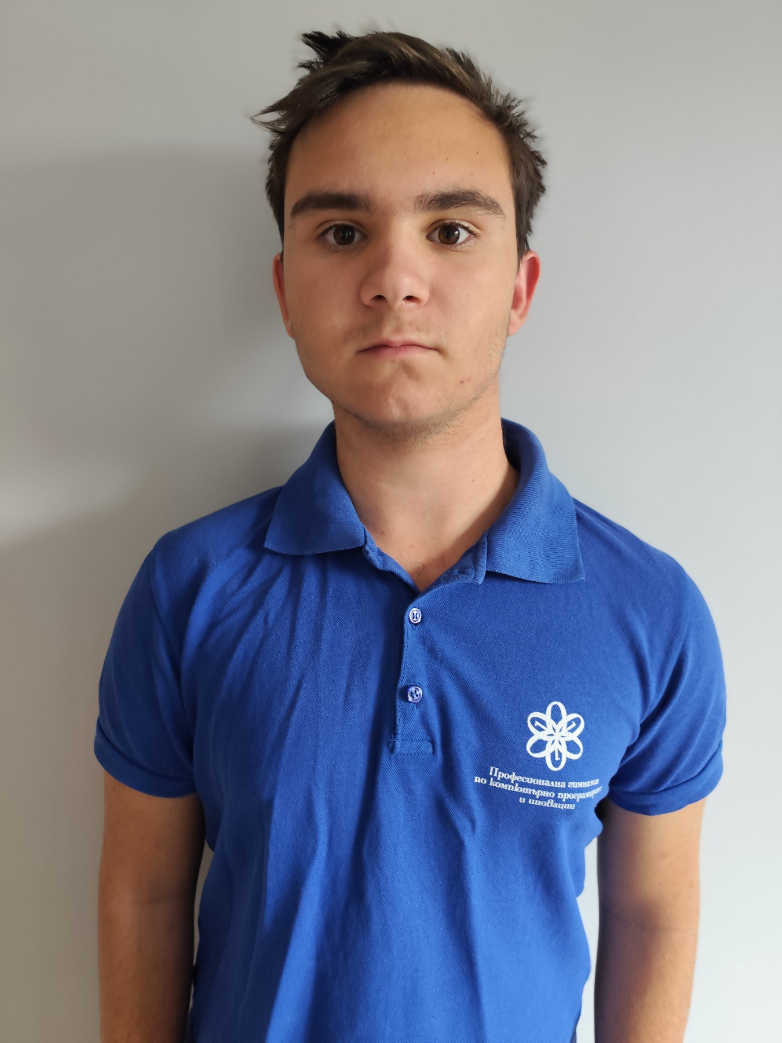
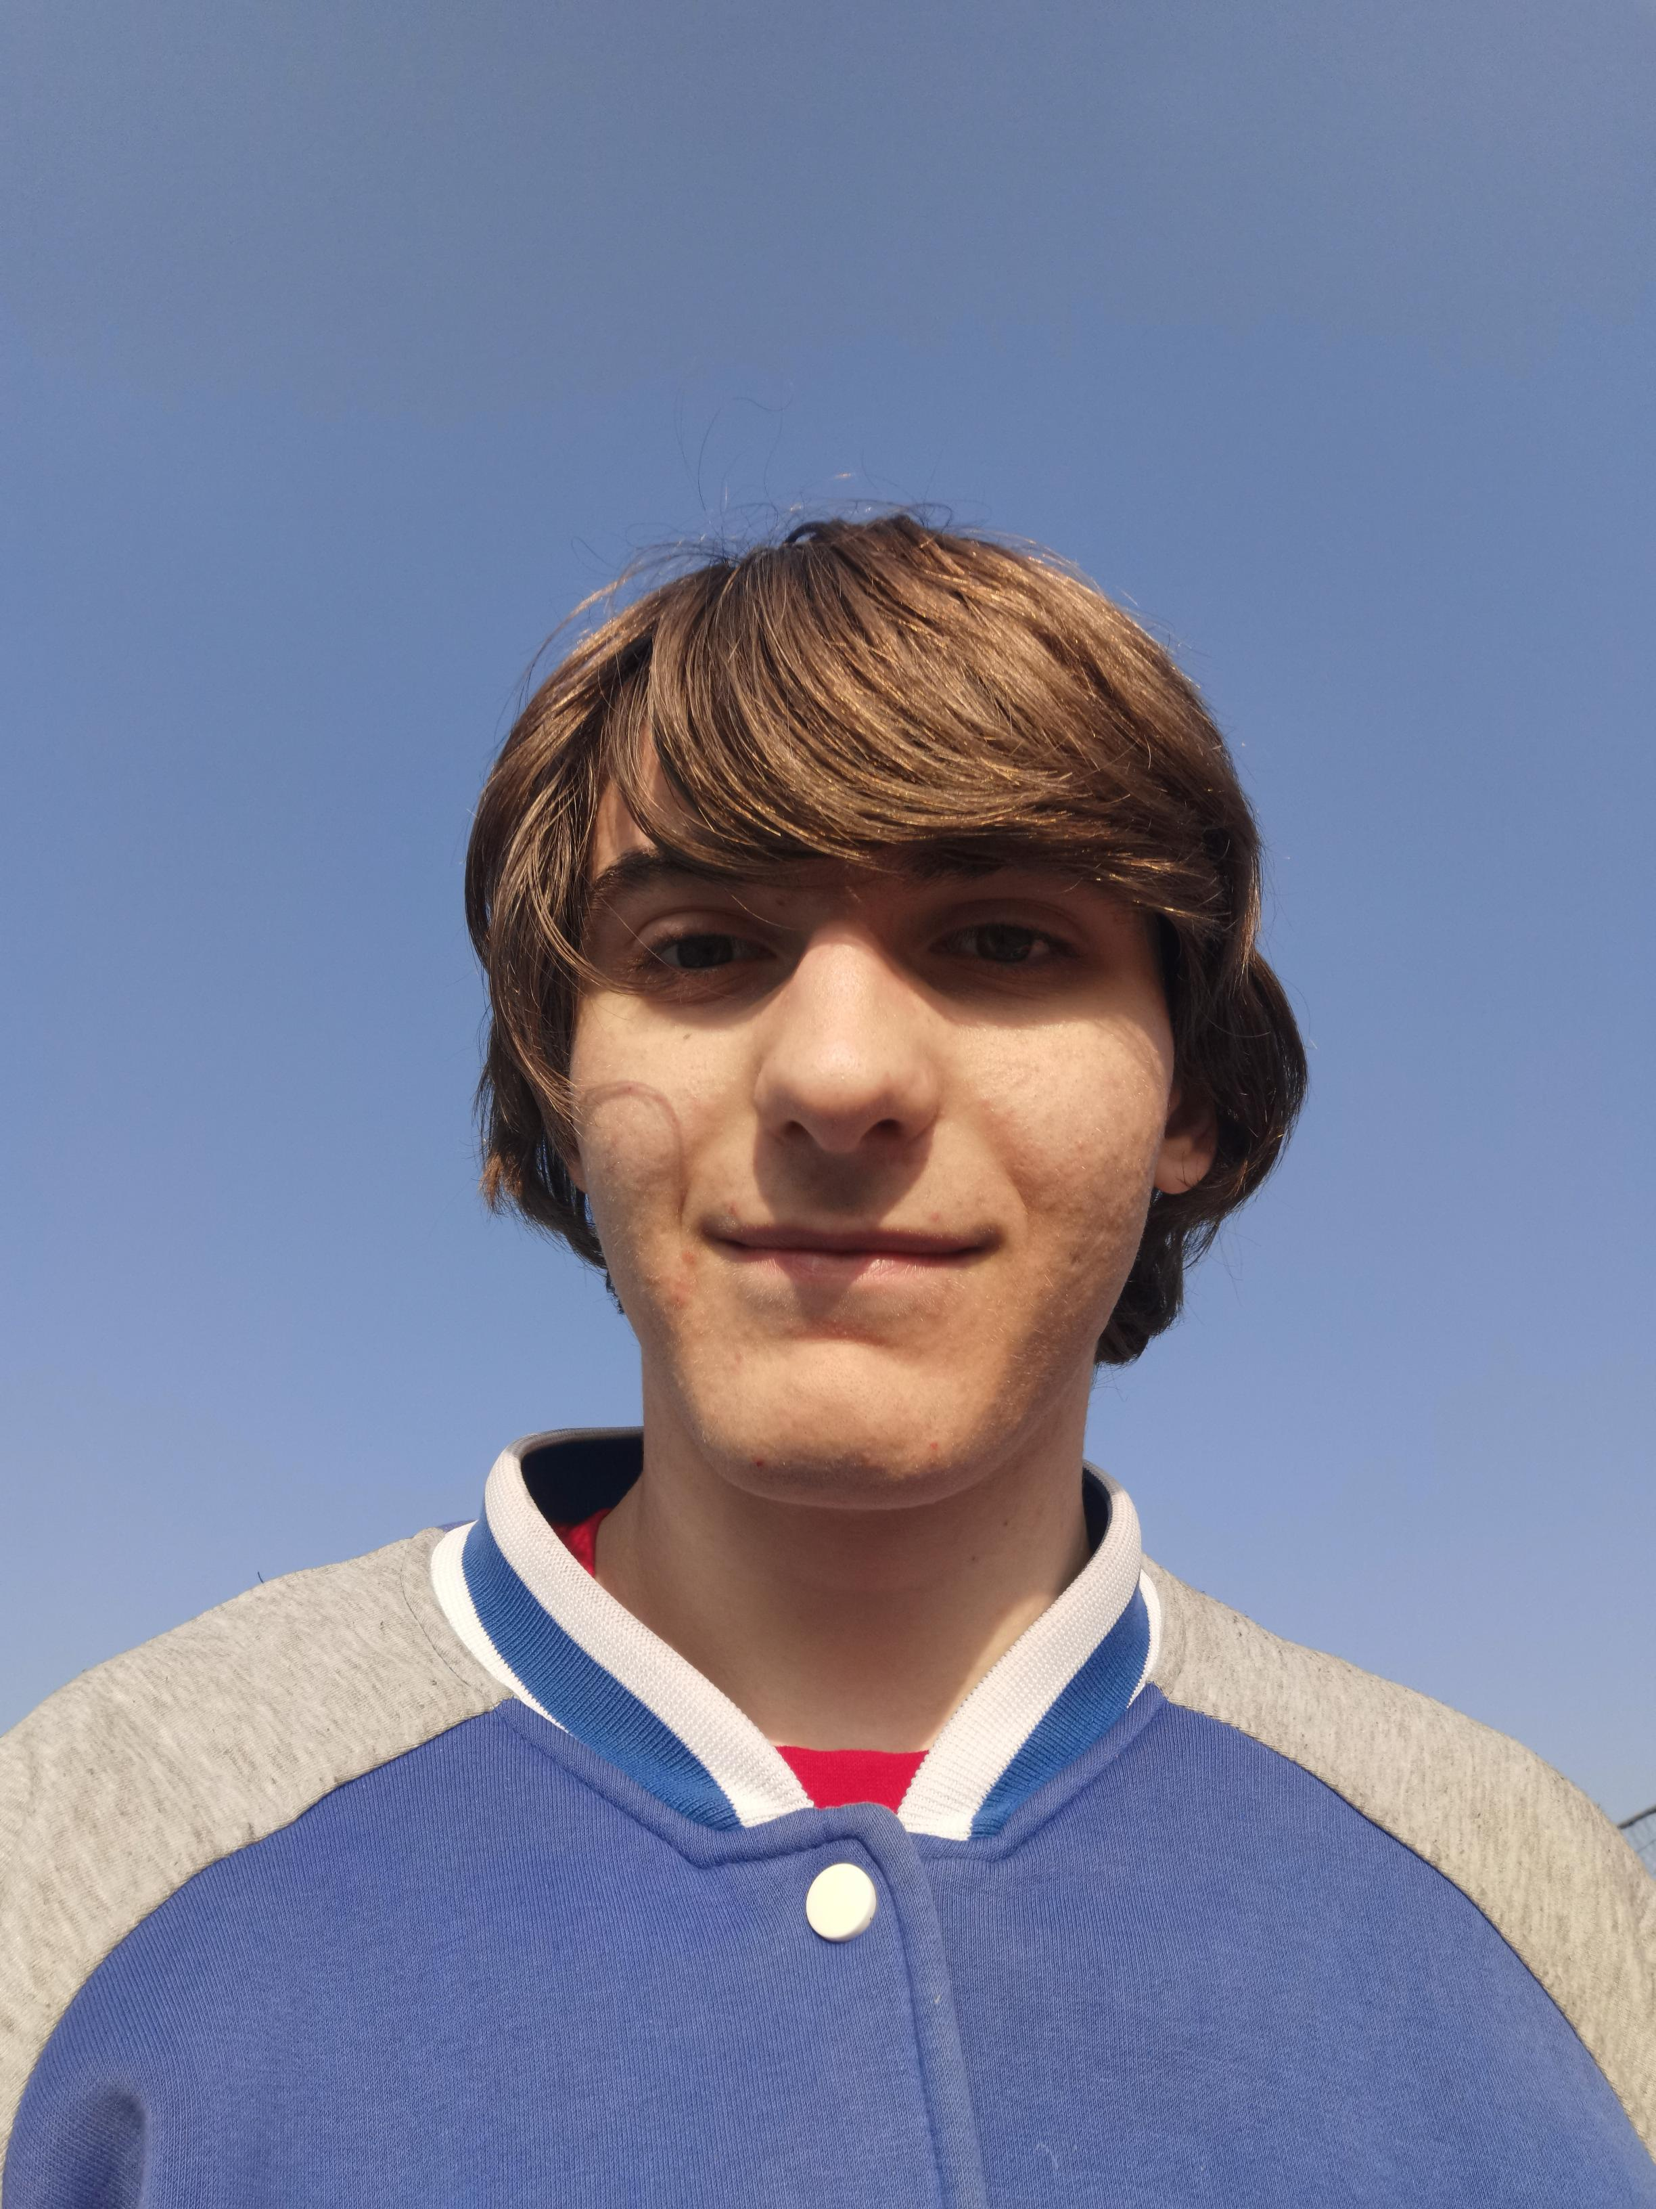
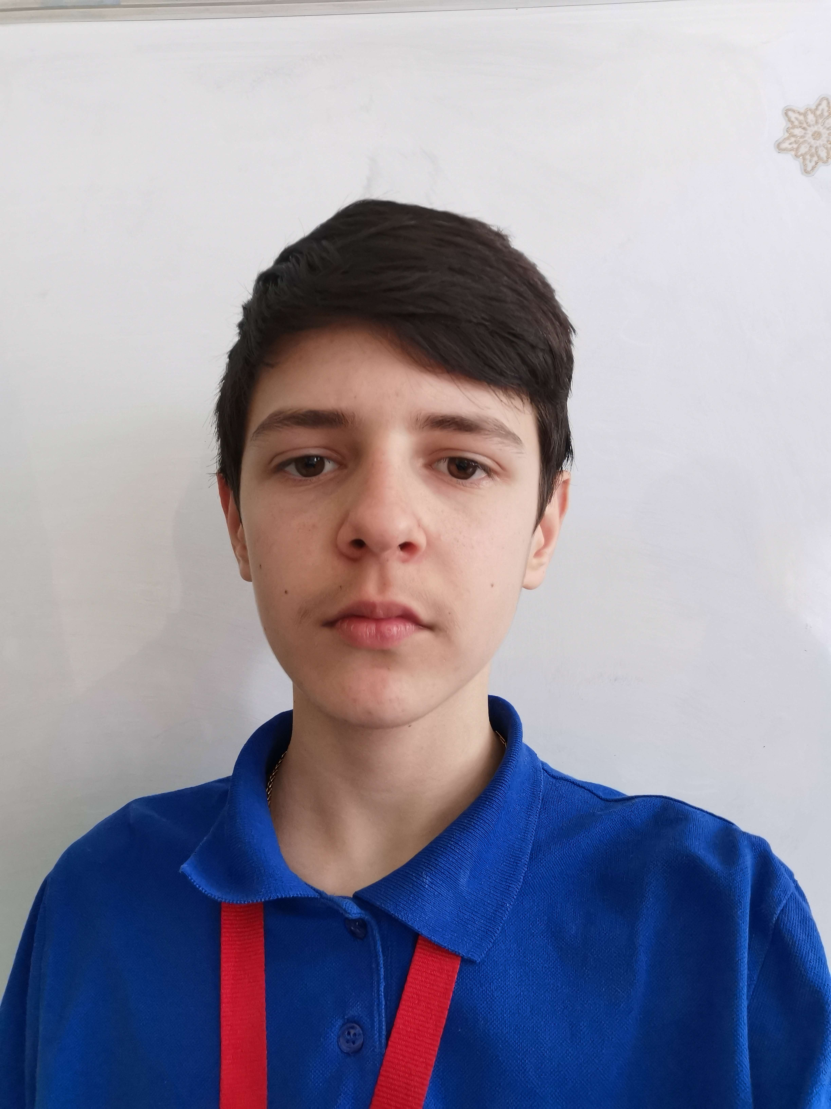
Our Team
Hristo Rusev
Scrum Trainer
Nikolai Zhelyazkov
Back-end developer
Designer
Zlatin Lazarov
Back-end developer
Stefan Radev
Back-end developer

Slide 3
Stages of creation
01
02
03
Choose an idea
Make documentation
Make an
application

Slide 4








Technologies

Slide 5
Let’s get to the application

